Slide 1

High Impact Skills Development Program
in Artificial Intelligence, Data Science, and Blockchain
Module 3: Data Science Fundamentals
Lecture 4: Identifying the Value of Data

Slide 2


The Power of Data: Unlocking Insights
Data is the lifeblood of decision-making in today's world, from business strategy to scientific discovery. It is the raw material for insights, predictions, and innovation.

Slide 3

The value of Data
“Data is the new oil. It's valuable, but if unrefined, it cannot really be used”
Clive Humby UK Mathematician and Data Science pioneer
Value of data = its potential to create insights, inform decisions, and generate revenue

Slide 4
The value of Data
Reduced Uncertainty
Improved Efficiency
1
2
Helps mitigate uncertainty, enabling better forecasts and more precise planning.
Insights optimize processes, leading to greater efficiency and productivity.
Enhanced Customer
Experience
Unveiling Hidden Patterns
3
4
Reveals underlying trends and patterns, uncovering new opportunities and insights.
Empowers businesses to personalize experiences and deliver tailored solutions.

Slide 5




Types of values
Implicit vs Explicit Data
Data can be expressed explicitly or implicitly, impacting how it is used and interpreted.
Explicit Data
Data that is directly stated or recorded, readily available and easy to analyze.
Implicit Data
Data that is not explicitly stated but can be inferred from other data sources or behaviors.
Example: Customer Reviews
Explicit reviews directly express opinions. Implicit data can be inferred from review length, tone, and product interactions.

Slide 6
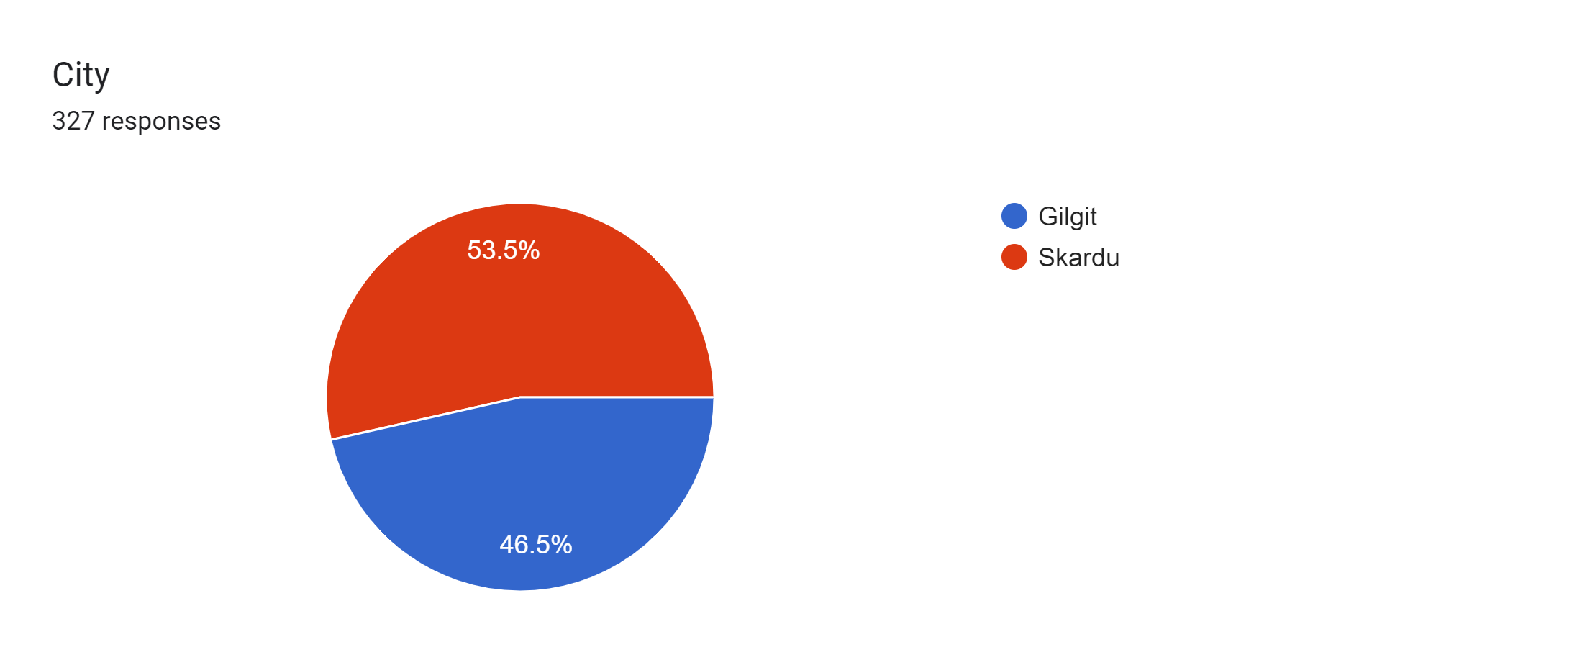

Slide 7
More on Explicit Values
What?
Explicit values are directly stated or measured and can be easily quantified.
How?
derived through various methods such as surveys, experiments, and observation.
Why?
provide crucial information for decision-making and strategy development.
By understanding explicit values, businesses can make informed decisions
that lead to increased efficiency and profitability.

Slide 8
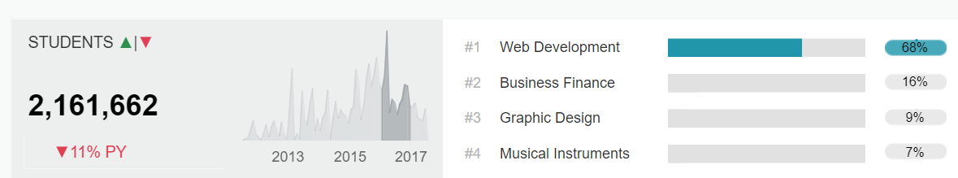
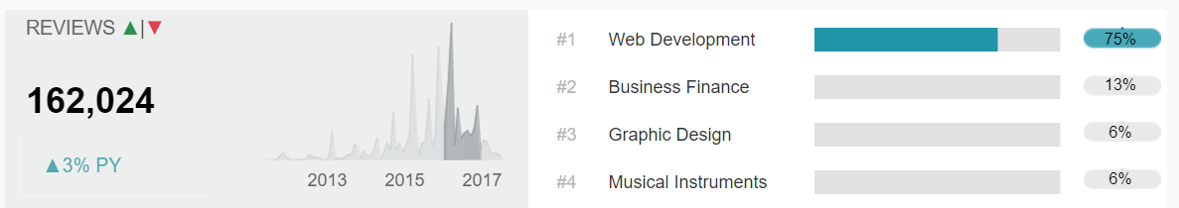
Udemy Surveyed Data

Slide 9
More on Implicit Values
What?
implied or inferred from the data.
How?
analyzing patterns, trends, and correlations in the data
Why?
Companies can tailor their marketing strategies and improve customer satisfaction
By analyzing sentiments of feedback and social media posts
Companies can also introduce new products or highlight some based on other market trends

Slide 10
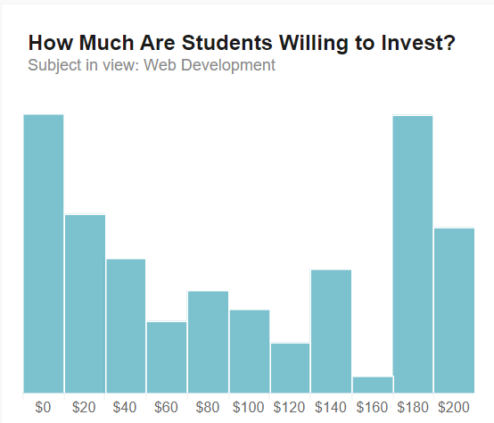
Udemy Surveyed Data

Slide 11
Value Extraction Methodologies
Descriptive analytics
Predictive analytics
Prescriptive analytics
analyzing past data to gain insights into what happened and why.
uses statistical models and machine learning algorithms to forecast future outcomes based on historical data.
recommending actions to optimize future outcomes.
Notes:
Descriptive analytics can be compared to looking in the rearview mirror while driving. It provides valuable information about what has already happened, but it doesn't help you avoid obstacles or make decisions in real-time. Predictive analytics is like looking through the windshield, giving you a glimpse of what's ahead so you can adjust your course accordingly. Finally, prescriptive analytics is like having a GPS system that not only tells you where to go, but also provides recommendations for the best route based on traffic and other factors.

Slide 12
Descriptive Analytics
Descriptive Statistics
Data Visualization
Cross-Tabulation
Frequency Analysis
Summary measures (mean, median, mode, etc.)
Charts, graphs, and maps
Analyzing occurrences and frequencies of data to understand its distribution and prevalence.
Used to describe central tendency, dispersion, and shape of numerical variables.
Represent data visually for intuitive understanding of patterns, relationships, and trends.
Categorical data
Summarizing and analyzing categorical data by tabulating and examining relationships between different categories.
Occurrence of categories or values

Slide 13
Predictive Analytics
Regression Analysis
Classification Algorithms
Clustering Algorithms
Neural Networks
models the relationship between a dependent variable and one or more independent variables.
helps in predicting numerical outcomes based on the values of other variables.
Used to predict categorical outcomes or assign instances to predefined classes based on input features and historical data.
Used to identify natural groupings or patterns in unlabeled data. Techniques such as k-means clustering, hierarchical clustering, and DBSCAN (Density-Based Spatial Clustering of Applications with Noise)
Neural networks, including deep learning architectures, are used for complex predictive tasks.
They learn hierarchical representations and patterns in data to make predictions or classifications.
e.g. Logistic Regression, Decision Trees, Support Vector Machines (SVM), k-Nearest Neighbors (k-NN)
Notes:
Predictive analytics is the use of statistical algorithms and machine learning techniques to analyze historical data and make predictions about future events or trends. It involves identifying patterns in data and using those patterns to forecast what might happen next.
One example of predictive analytics in action is a credit scoring model used by banks to assess the likelihood that a borrower will default on a loan. The model uses data such as the borrower's credit history, income, and employment status to predict the risk of default. This allows the bank to make more informed lending decisions and minimize their risk of losses.

Slide 14
Prescriptive Analytics
Optimization Modeling
Simulation
e.g. Monte Carlo Simulation, Agent-Based Modeling, Discrete Event Simulation
Decision Analysis
e.g. Decision Trees, Multi-Criteria Decision Analysis (MCDA), Analytic Hierarchy Process (AHP)
Prescriptive Machine Learning
e.g. Reinforcement Learning, Genetic Algorithms, Neural Network Optimization
Mathematical optimization techniques to find the best solution from feasible options.
e.g. Linear Programming (LP), Integer Programming (IP), Nonlinear Programming (NLP)
Creating computer models to understand real-world scenarios and their outcomes.
Structured approaches to decision-making under uncertainty.
Combining predictive models with optimization techniques for actionable insights.
Notes:
Prescriptive analytics is a type of data analysis that goes beyond descriptive and predictive analytics. It not only tells you what has happened and what is likely to happen, but also provides recommendations on what actions to take. This is achieved through the use of optimization algorithms and decision-making models.
For example, a retailer may use prescriptive analytics to determine the optimal price for a product based on factors such as demand, competition, and inventory levels. The algorithm would analyze historical sales data and market trends to recommend the best price point that maximizes profit while still remaining competitive in the market.

Slide 15
Stakeholders of Value
Data scientists
develop the algorithms and models to extract insights from their data.
Analysts
focused on interpreting the data and communicating insights to stakeholders
Business Leaders
business leaders understand the implications of the data and make informed decisions based on the findings

Slide 16
The role of Data Scientists
A Very important part of the Value identification process.
Responsible for analyzing large amounts of data and using various methods to extract insights
Use a variety of tools and techniques
E.g. In Healthcare
Analyze large amounts of patient data
Identify patterns and trends
Help doctors make accurate diagnoses
Help develop more effective treatment plans.
Thus improving patient care and healthcare service delivery.

Slide 17
Identifying Value: Exercise 1
E.g. Online retailer
Analyze customer behavior and purchasing patterns
If a user buy shoes, what should you recommend next?
What kind of analysis is this?
Descriptive Analysis
Predictive Analysis
Prescriptive Analysis

Slide 18
Identifying Value: Exercise 2
E.g. Transportation Business
Analyzing traffic patterns and Optimizing routes
We got a new bus, which route should it run on?
What kind of analysis is this?
Descriptive Analysis
Predictive Analysis
Prescriptive Analysis

Slide 19
Identifying Value: Exercise 3
E.g. Health Sites in Pakistan
Which regions have the least number of hospitals?
What kind of specialist should be hired?

Slide 20
From Data to Wisdom
Decision Risk
Wisdom
Knowledge
Information
Data

Slide 21

Happy Learning!

